Slide 1
Working with Dates and Time
Shiva K

Slide 2
We spend lot of time thinking about deadlines and schedules.
How many days do I have until my birthday?
When is my project due?
I want to book an appointment in two weeks. What will the date be?

Slide 3
To solve these problems with computers, we need to store and manipulate dates and times.

Slide 4
If I want to know how many days until my birthday, first I need today’s date.
The datetime class allows us to get current date and time.
# The import statement gives us access to the functionality of the date and time.
import
import datetime
# today is a function that returns today’s date.
print(datetime.date.today())

Slide 5
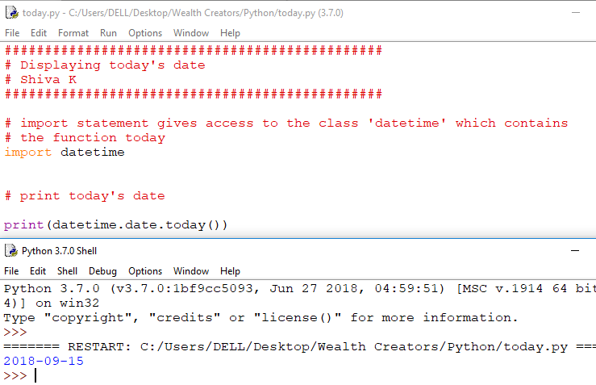

Slide 6
You can store dates in variables
#importing datetime class
import datetime
# Stores today’s date in a variable
currentDate = datetime.date.today()
# prints currentDate
print(currentDate)

Slide 7
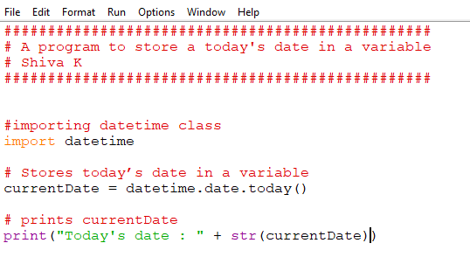
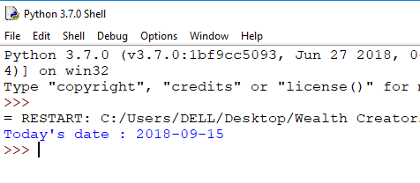

Slide 8
You can access different parts of the date
#importing datetime class
import datetime
# Stores today’s date in a variable
currentDate = datetime.date.today()
# prints currentDate
print(currentDate)
print(currentDate.month)
print(currentDate.year)
Print(currentDate.day)

Slide 9
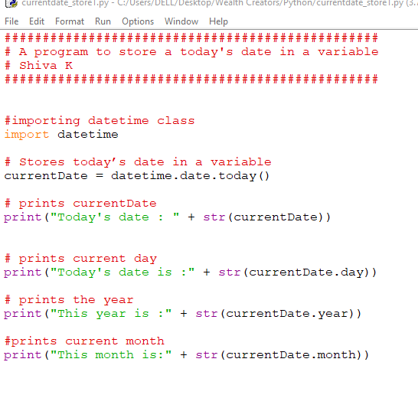

Slide 10
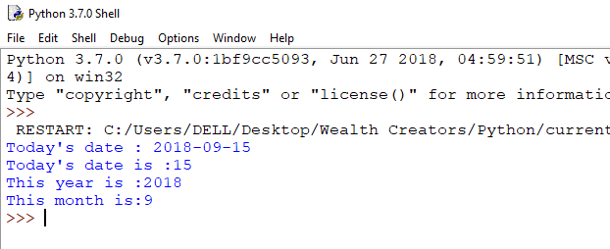

Slide 11
Date formats
What date does 2/8/2014 represent?

Slide 12
But,what if you want to display date with a different format?
Welcome to one of the things that drives programmers insane!
Different countries and different users need different date formats,often defalut is not what you want.
There is always way to handle it,but it take will take time and extra code.
The defalut format is YYYY-MM-DD

Slide 13
In Python,we use strftime to format the dates.
# import datetime library(class)
import datetime
# Assign today’s date to currentDate variable
currentDate = datetime.date.today()
print(currentDate.strftime(“%d %b, %Y”))

Slide 14
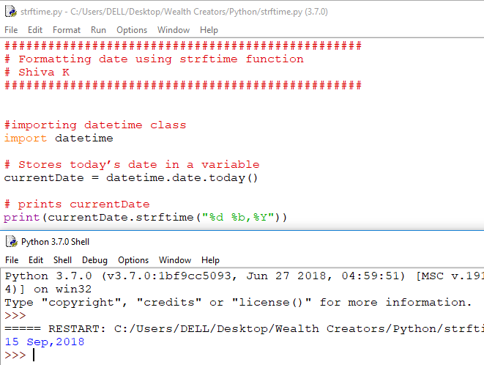

Slide 15
What the heck are %d,%b and %Y?
%d is the day of a month
% b is the month
%Y is the year in YYYY format

Slide 16
Here’s a few more you may find useful.
% a is the day of a week abbreviated
%A is the full day name of a week
%b is the month abbreviation
% B is the full month name
%y is the year in YY format(2 digit)
%Y is the year in YYYY format(4 digit)
For more,visit strftime.org

Slide 17
Could you print out a wedding invitation?
“Please attend our event Sunday, July 20 in the year 2018”
import datetime
currentDate = datetime.date.today()
print(“currentDate.strftime(“Please attend our event %B, %A %d in the year %Y”)

Slide 18
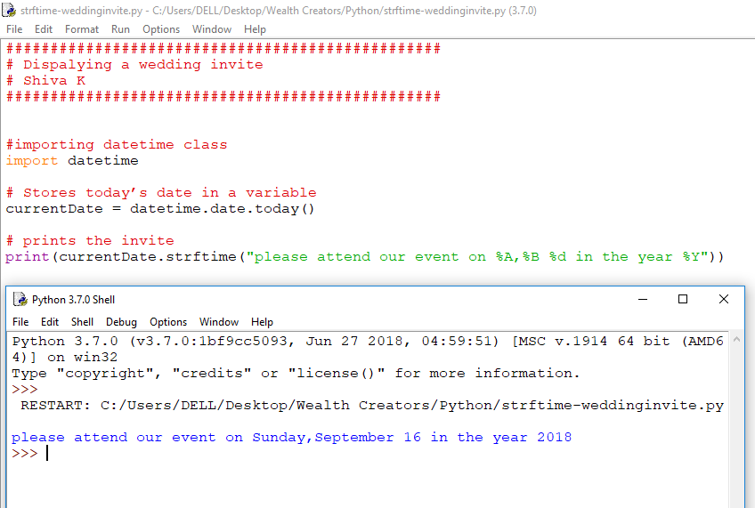

Slide 19
Let’s get back to calculating days until your birthday,I need to ask your birthday.
birthDate = input(“What is your birthdate?”)
print(“Your birthday is: ” + birthDate)

Slide 20
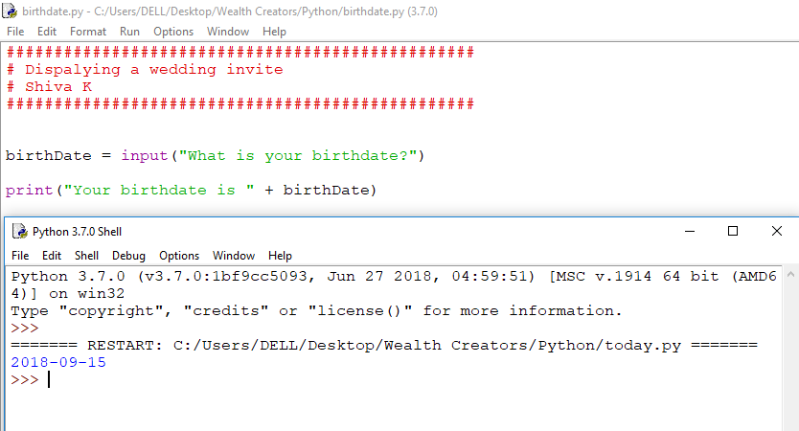

Slide 21
What datatype is birthDate?
String
What if we want to convert it into Date datatype(for e.g. If we want to apply datetime functions like strftime to print the date)??
We need a way to do it.

Slide 22
The strptime allows you to convert string to date datatype.
import datetime
birthday = input(“What is your birthday?”)
birthdate = datetime.datetime.strptime(birthday,“ %d/%m/%Y”).date()
print(“Your birth month is “ + birthdate.strftime(“%B”)

Slide 23
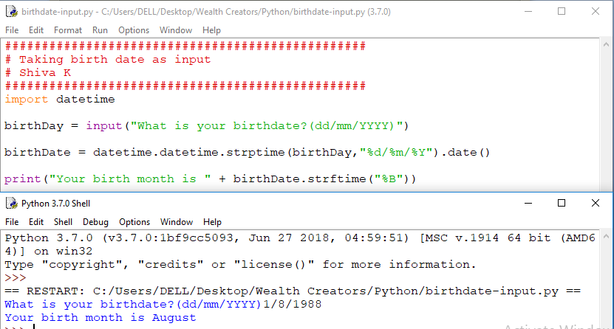

Slide 24
Why did we type datetime twice?
birthdate = datetime.datetime.strptime(birthday,“ %d/%m/%Y”).date()
Because,we are calling the strptime function from datetime module which is in datetime class.

Slide 25
What if the user does not give the input in the format that I specify in strptime function?
birthdate = datetime.datetime.strptime(birthday,“ %d/%m/%Y”).date()
Your code will crash!
Tell the user the way you want the input to be given
birthdate = input(“your birthdate(dd/mm/YYYY) ?”)
Add error handling

Slide 26
Dates seem like lot of hassle, is it worth it? Why not,just store them as strings!
You can create a countdown to until a big event or
Your next birthday!
nextbirthDay =
datetime.datetime.strptime(“01/08/2019”,”%d/%m/%Y”).date()
currentDate = datetime.date.today()
difference = nextbirthDay - currentDate

Slide 27
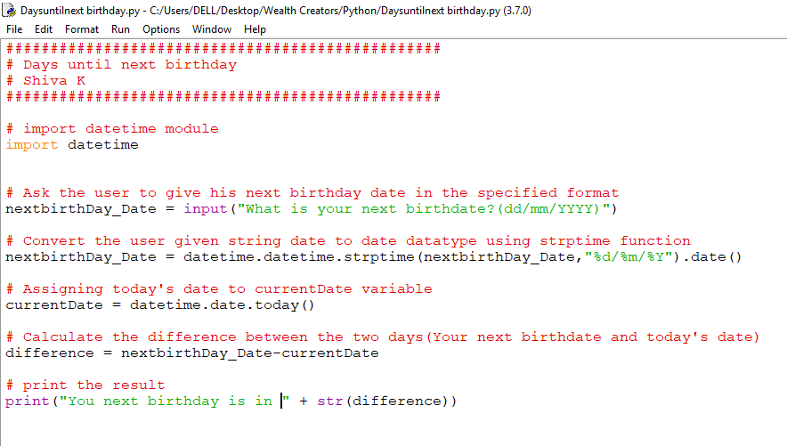

Slide 28
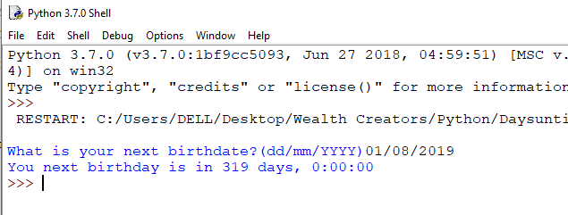

Slide 29
You can tell someone when their milk in fridge will expire using timedelta function!
currentDate = datetime.date.today()
# timedelta allows you to specify the time
# to add or subtract from a date
print(currentDate + datetime.timedelta(days = 15)
print(currentDate + datetime.timedelta(hours = 15)

Slide 30
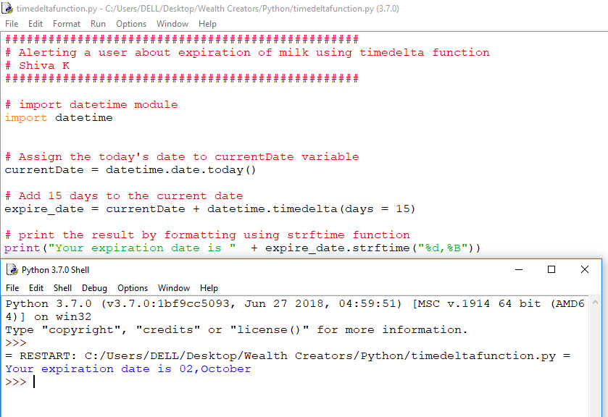

Slide 31
You will be amazed how often you need to work with dates!
If datetime does not have what you need ,checkout the dateutil library!

Slide 32
Working with time.
It is called datetime, it can store time.

Slide 33
datetime.datetime.now()
# import datetime module
import datetime
currentTime = datetime.datetime.now()
print(currentTime)
print(currentTime.hour)
print(currentTime.minute)
Print(currentTime.second)

Slide 34
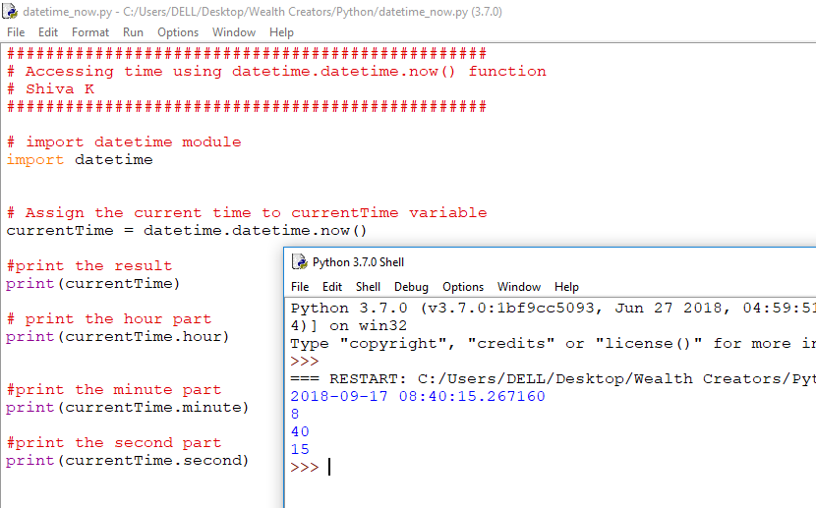

Slide 35
Just like dates you can use strftime function to format the way a time is displayed
import datetime
currentTime = datetime.datetime.now()
print(datetime.datetime.strftime(currentTime,”%H:%m”)

Slide 36
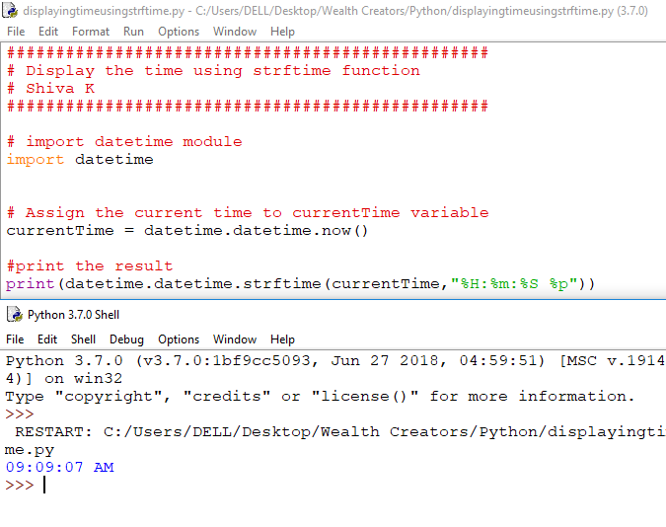

Slide 37
Some useful format specifiers!
%H - Hours (24 hr clock)
%I - Hours (12 hr clock)
%p - AM or PM
%m - Minutes
%S - Seconds

Slide 38
Your challenge
Ask a user to enter the deadline for their project
Tell them how many days they have to complete the project
For extra credit, give them the answer as a combination of weeks & days (Hint: you will need some of the math functions from the module on numeric values)

Slide 39
Congratulations!
You can now format dates and times
You can perform calculations with date values

